Slide 1
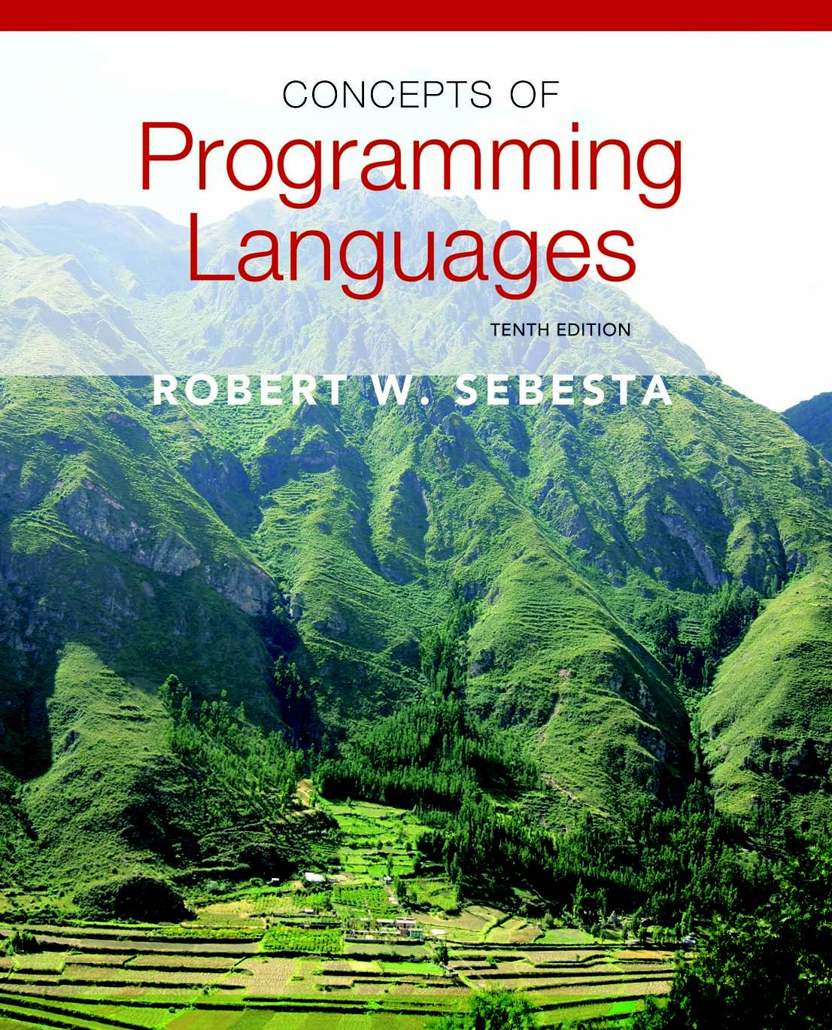
Copyright © 2012 Addison-Wesley. All rights reserved.

Slide 2
Lecture 2: Syntax and Semantics
Chapter 3*
*Note: Some materials in Chapter 3 are optional coverage, and chapter 4 is not covered in this course.

Slide 3
Topics
Introduction
Methods of Describing Syntax
Syntax graph
BNF and EBNF
Attribute grammars
Syntax plus semantics
Semantics descriptions
Operational semantics
Denotational semantics
Axiomatic semantics

Slide 4
Introduction
Syntax: the form or structure of the expressions, statements, and program units
Semantics: the meaning of the expressions, statements, and program units
Syntax and semantics provide a language’s definition
Users of a language definition
Other language designers
Implementers
Programmers (the users of the language)

Slide 5
Describing the syntax
Syntax diagram
Simple, easy to read but not powerful enough to describe complexity in syntax, not support for compiler generator
BNF and Context-free grammar
CS3110: Formal Languages and Automata

Slide 6
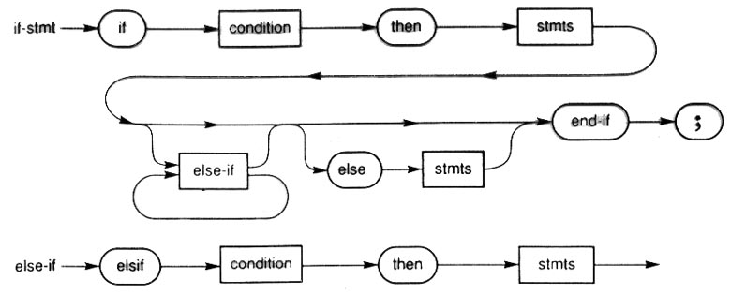
Syntax diagram: Example

Slide 7
BNF and Context-Free Grammars
Context-Free Grammars
Developed by Noam Chomsky in the mid-1950s
Language generators, meant to describe the syntax of natural languages
Define a class of languages called context-free languages
Backus-Naur Form (1959)
Invented by John Backus to describe Algol 58
BNF is equivalent to context-free grammars
Context-Free Grammars
Developed by Noam Chomsky in the mid-1950s
Language generators, meant to describe the syntax of natural languages
Define a class of languages called context-free languages
Backus-Naur Form (1959)
Invented by John Backus to describe Algol 58
BNF is equivalent to context-free grammars
Context-Free Grammars
Developed by Noam Chomsky in the mid-1950s
Language generators, meant to describe the syntax of natural languages
Define a class of languages called context-free languages
Backus-Naur Form (1959)
Invented by John Backus to describe Algol 58
BNF is equivalent to context-free grammars

Slide 8
Sample BNF Rules
An abstraction (or nonterminal symbol) can have more than one RHS
<stmt> → <single_stmt>
| begin <stmt_list> end

Slide 9
An Example Grammar
<program> → <stmts>
<stmts> → <stmt> | <stmt> ; <stmts>
<stmt> → <var> = <expr>
<var> → a | b | c | d
<expr> → <term> + <term> | <term> - <term>
<term> → <var> | const
Ambiguous and unambiguous grammars

Slide 10
Extended BNF (EBNF)
Optional parts are placed in brackets [ ]
<proc_call> -> ident [(<expr_list>)]
Alternative parts of RHSs are placed inside parentheses () and separated via vertical bars |
<term> → <term> (+|-) const
Repetitions (0 or more) are placed inside braces { }
<ident> → letter {letter|digit}

Slide 11
BNF and EBNF
BNF
<expr> → <expr> + <term>
| <expr> - <term>
| <term>
<term> → <term> * <factor>
| <term> / <factor>
| <factor>
EBNF
<expr> → <term> {(+ | -) <term>}
<term> → <factor> {(* | /) <factor>}

Slide 12
Examples
Java Syntax Rules
https://docs.oracle.com/javase/specs/jls/se7/html/jls-2.html
http://cui.unige.ch/isi/bnf/JAVA/BNFindex.html
Python Syntax Rules
https://docs.python.org/3/reference/grammar.html

Slide 13
Semantics
There is no single widely acceptable notation or formalism for describing semantics
Several needs for a methodology and notation for semantics:
Programmers need to know what statements mean
Compiler writers must know exactly what language constructs do
Correctness proofs would be possible
Compiler generators would be possible
Designers could detect ambiguities and inconsistencies

Slide 14
Describing Semantics
Attribute grammar
Syntax-directed translations
Operational semantics
Informal way of describing the semantics
Popularly used
Denotational semantics
Formal description of semantics
Axiomatic Semantics
Based on formal logic

Slide 15
Attribute Grammars: Definition
Def: An attribute grammar is a context-free grammar G = (S, N, T, P) with the following additions:
For each grammar symbol x there is a set A(x) of attribute values
Each rule has a set of functions that define certain attributes of the nonterminals in the rule
Each rule has a (possibly empty) set of predicates to check for attribute consistency
Def: An attribute grammar is a context-free grammar G = (S, N, T, P) with the following additions:
For each grammar symbol x there is a set A(x) of attribute values
Each rule has a set of functions that define certain attributes of the nonterminals in the rule
Each rule has a (possibly empty) set of predicates to check for attribute consistency

Slide 16
Attribute Grammars: explanation
Semantic meanings (i.e. actions) associated with CFG rules
Limited power
Examples
Arithmetic expression evaluation
Type checking of expressions and statements

Slide 17
Attribute Grammars: An Example
Syntax
<assign> -> <var> = <expr>
<expr> -> <var> + <var> | <var>
<var> A | B | C
actual_type: synthesized for <var> and <expr>
expected_type: inherited for <expr>

Slide 18
Attribute Grammar (continued)
Syntax rule: <expr> → <var>[1] + <var>[2]
Semantic rules:
<expr>.actual_type ← <var>[1].actual_type
Predicate:
<var>[1].actual_type == <var>[2].actual_type
<expr>.expected_type == <expr>.actual_type
Syntax rule: <var> → id
Semantic rule:
<var>.actual_type ← lookup (<var>.string)

Slide 19
Operational Semantics
Operational Semantics
Describe the meaning of a program by executing its statements on a machine, either simulated or actual. The change in the state of the machine (memory, registers, etc.) defines the meaning of the statement
To use operational semantics for a high-level language, a virtual machine is needed

Slide 20
Operational Semantics – Interpreter
A hardware pure interpreter would be too expensive
A software pure interpreter also has problems
The detailed characteristics of the particular computer would make actions difficult to understand
Such a semantic definition would be machine- dependent

Slide 21
Operational Semantics - Simulation
A better alternative: A complete computer simulation
The process:
Build a translator (translates source code to the machine code of an idealized computer)
Build a simulator for the idealized computer
Evaluation of operational semantics:
Good if used informally (language manuals, etc.)
Extremely complex if used formally (e.g., VDL), it was used for describing semantics of PL/I.

Slide 22
Operational Semantics - Evaluation
Uses of operational semantics:
- Language manuals and textbooks
- Teaching programming languages
- Good if used informally (language
manuals, etc.)
- Extremely complex if used formally (e.g.,VDL)

Slide 23
Operational Semantics – Practice
Translate the following for-statement into assembly (psudeo-code)
for (count = 0; count < max; count ++)
cost = cost + count * unit_price;
(note: knowledge of CS264 very helpful.)

Slide 24
Denotational Semantics
Based on recursive function theory
The most abstract semantics description method
Originally developed by Scott and Strachey (1970)

Slide 25
Denotational Semantics: program state
The state of a program is the values of all its current variables
s = {<i₁, v₁>, <i₂, v₂>, …, <i_{n}, v_{n}>}
Let VARMAP be a function that, when given a variable name and a state, returns the current value of the variable
VARMAP(i_{j}, s) = v_{j}

Slide 26
Decimal Numbers
<dec_num> → '0' | '1' | '2' | '3' | '4' | '5' |
'6' | '7' | '8' | '9' |
<dec_num> ('0' | '1' | '2' | '3' |
'4' | '5' | '6' | '7' |
'8' | '9')
M_{dec}('0') = 0, M_{dec} ('1') = 1, …, M_{dec} ('9') = 9
M_{dec} (<dec_num> '0') = 10 * M_{dec} (<dec_num>)
M_{dec} (<dec_num> '1’) = 10 * M_{dec} (<dec_num>) + 1
…
M_{dec} (<dec_num> '9') = 10 * M_{dec} (<dec_num>) + 9

Slide 27
Expressions
M_{e}(<expr>, s) Δ=
case <expr> of
<dec_num> => M_{dec}(<dec_num>, s)
<var> =>
if VARMAP(<var>, s) == undef
then error
else VARMAP(<var>, s)
<binary_expr> =>
if (M_{e}(<binary_expr>.<left_expr>, s) == undef
OR M_{e}(<binary_expr>.<right_expr>, s) =
undef)
then error
else
if (<binary_expr>.<operator> == '+' then
M_{e}(<binary_expr>.<left_expr>, s) +
M_{e}(<binary_expr>.<right_expr>, s)
else M_{e}(<binary_expr>.<left_expr>, s) *
M_{e}(<binary_expr>.<right_expr>, s)
...

Slide 28
Assignment Statements
Maps state sets to state sets U {error}
M_{a}(x := E, s) Δ=
if M_{e}(E, s) == error
then error
else s’ = {<i₁,v₁’>,<i₂,v₂’>,...,<i_{n},v_{n}’>},
where for j = 1, 2, ..., n,
if i_{j} == x
then v_{j}’ = M_{e}(E, s)
else v_{j}’ = VARMAP(i_{j}, s)

Slide 29
Evaluation of Denotational Semantics
Can be used to prove the correctness of programs
Provides a rigorous way to think about programs
Can be an aid to language design
Has been used in compiler generation systems
Because of its complexity, it are of little use to language users

Slide 30
Axiomatic Semantics
Based on formal logic (predicate calculus)
Original purpose: formal program verification
Axioms or inference rules are defined for each statement type in the language (to allow transformations of logic expressions into more formal logic expressions)
The logic expressions are called assertions
Preconditions: prior to the assertion
Postconditions: after the assertion

Slide 31
Axiomatic Semantics Form
Pre-, post form: {P} statement {Q}
An example
a = b + 1 {a > 1}
One possible precondition: {b > 10}
Weakest precondition: {b > 0}

Slide 32
Axiomatic Semantics: Axioms
An axiom for assignment statements (x = E): {Q_{x->E}} x = E {Q}
The Rule of Consequence:
Notes:
32

Slide 33
Axiomatic Semantics: Axioms
An inference rule for sequences of the form S1; S2
{P1} S1 {P2}
{P2} S2 {P3}
Notes:
33

Slide 34
Summary
BNF and context-free grammars are equivalent meta-languages
Well-suited for describing the syntax of programming languages
An attribute grammar is a descriptive formalism that can describe both the syntax and the semantics of a language
Three primary methods of semantics description
Operational, denotational, axiomatic
BNF and context-free grammars are equivalent meta-languages
Well-suited for describing the syntax of programming languages
An attribute grammar is a descriptive formalism that can describe both the syntax and the semantics of a language
Three primary methods of semantics description

